Slide 1



The Smart Mobile Messenger.

Slide 2

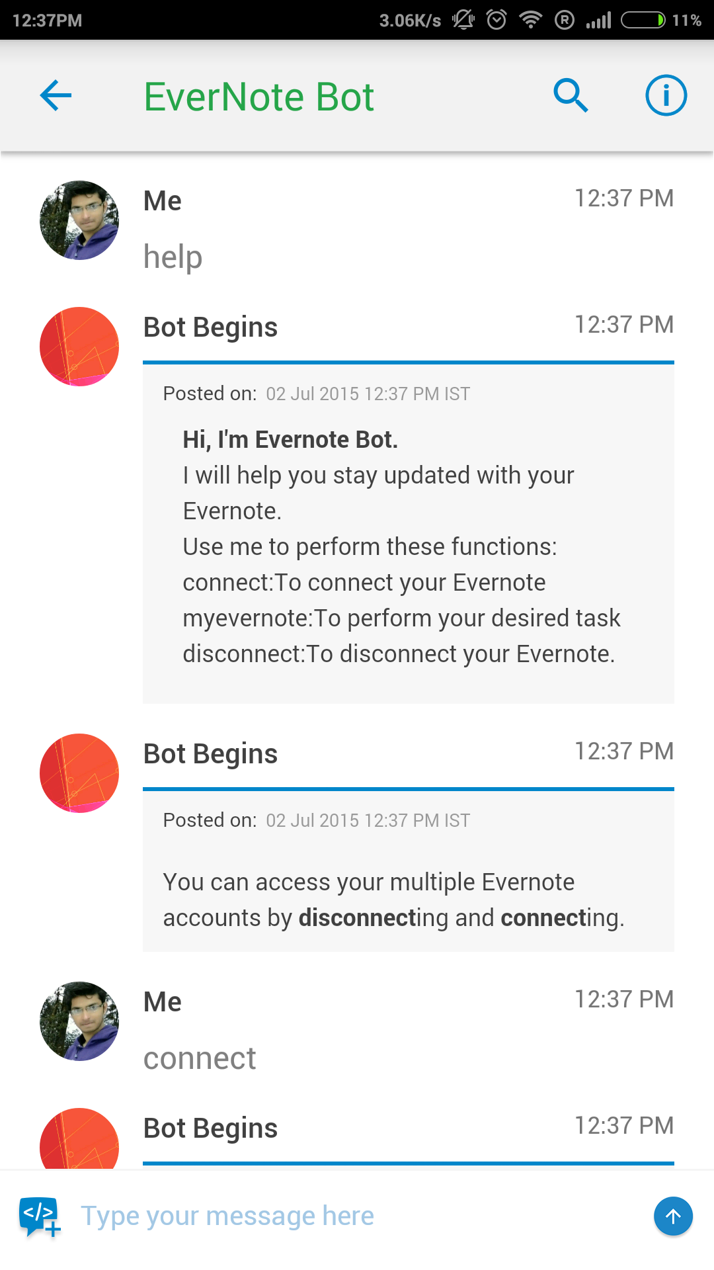

Teamchat App introduces "Evernote" integration
Now with "Evernote" integration on Teamchat stay updated to your evernotes.
Entering the keyword "help post a chatlet.
A token/pin is generated after sign in.

Slide 3
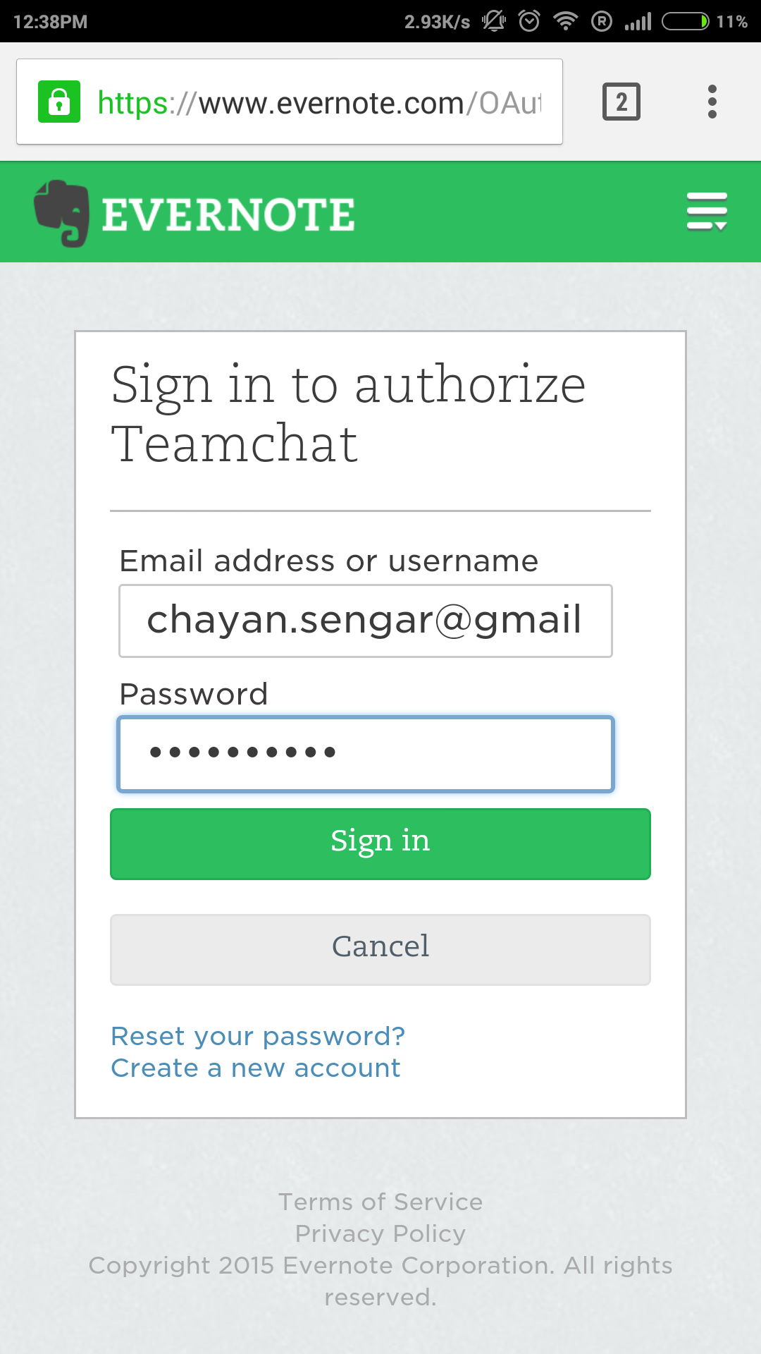
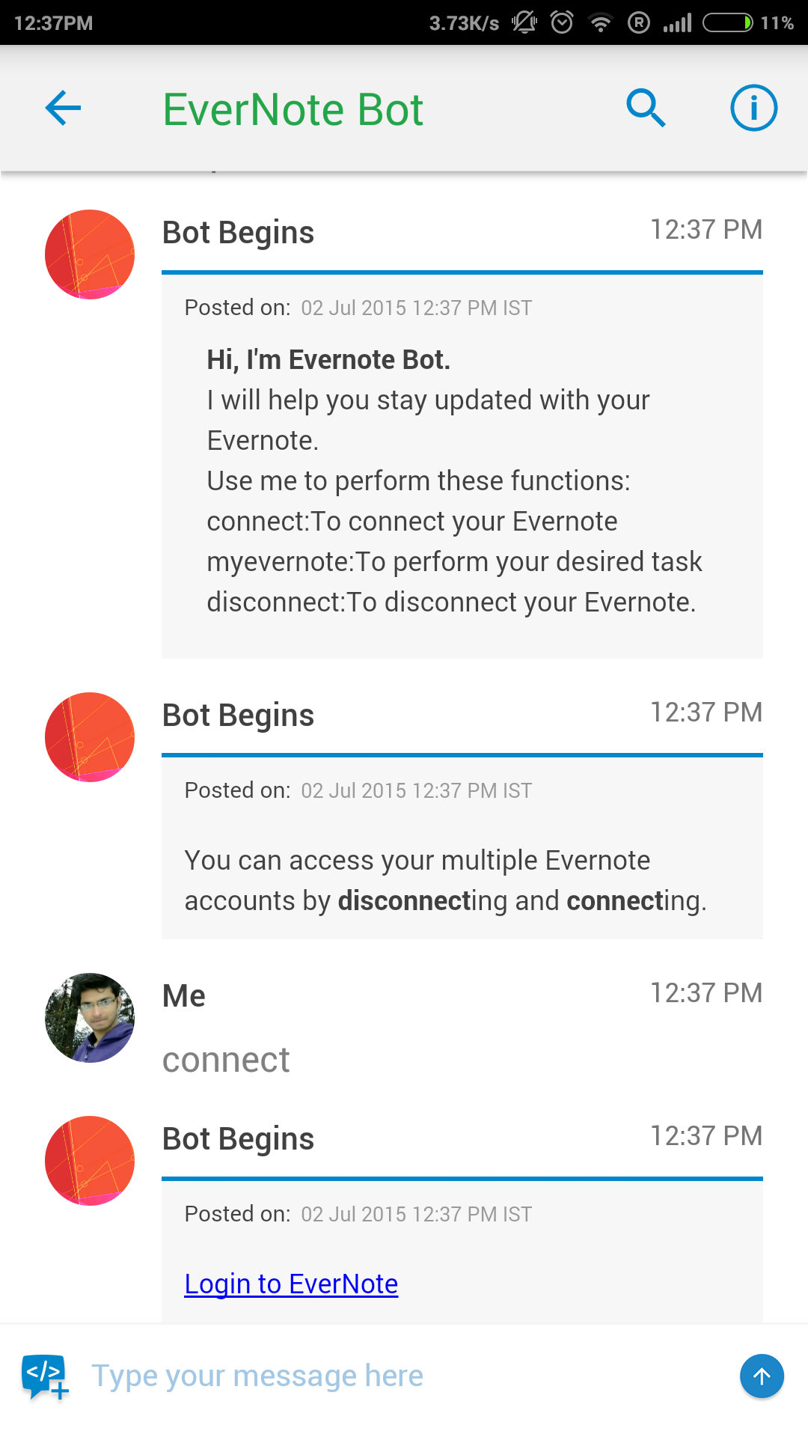
Teamchat App introduces "Gotomeeting" integration
A link is posted by the bot. Clicking on the link takes us to browser.
Type ‘connect’ to configure your evernote account.

Slide 4
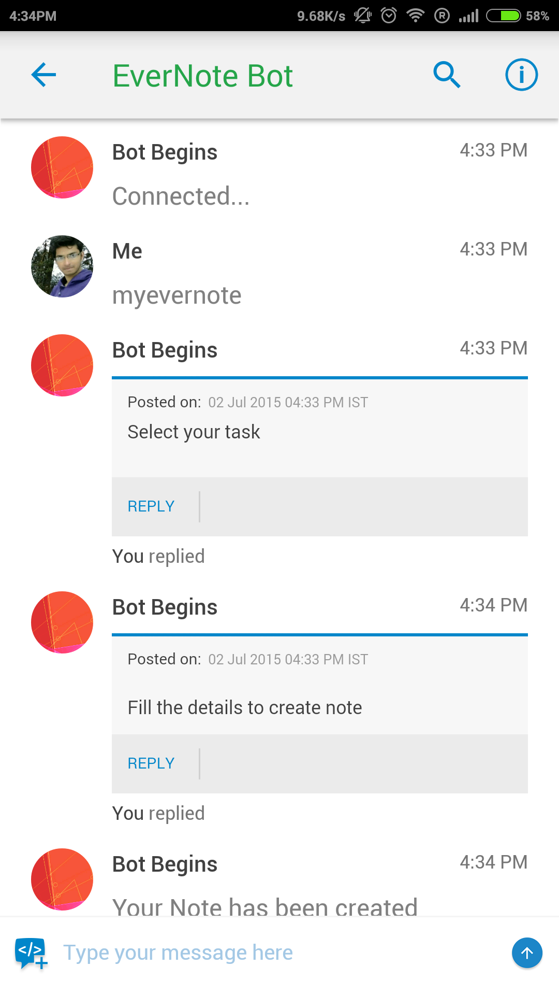
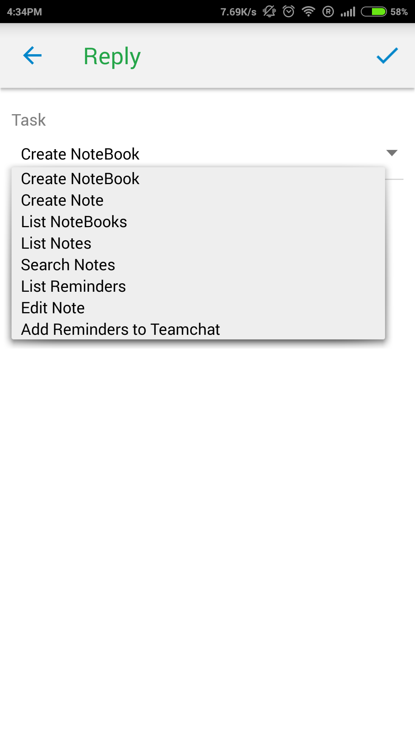
Teamchat App introduces "Gotomeeting" integration
Select task from the dropdown button.
If correct credential are input the bot post a success message.
To perform different tasks type keyword “myevernote”.

Slide 5
Add note on Evernote
Select task from the dropdown button.
If correct credential are input the bot post a success message.
To perform different tasks type keyword “myevernote”.

Slide 6
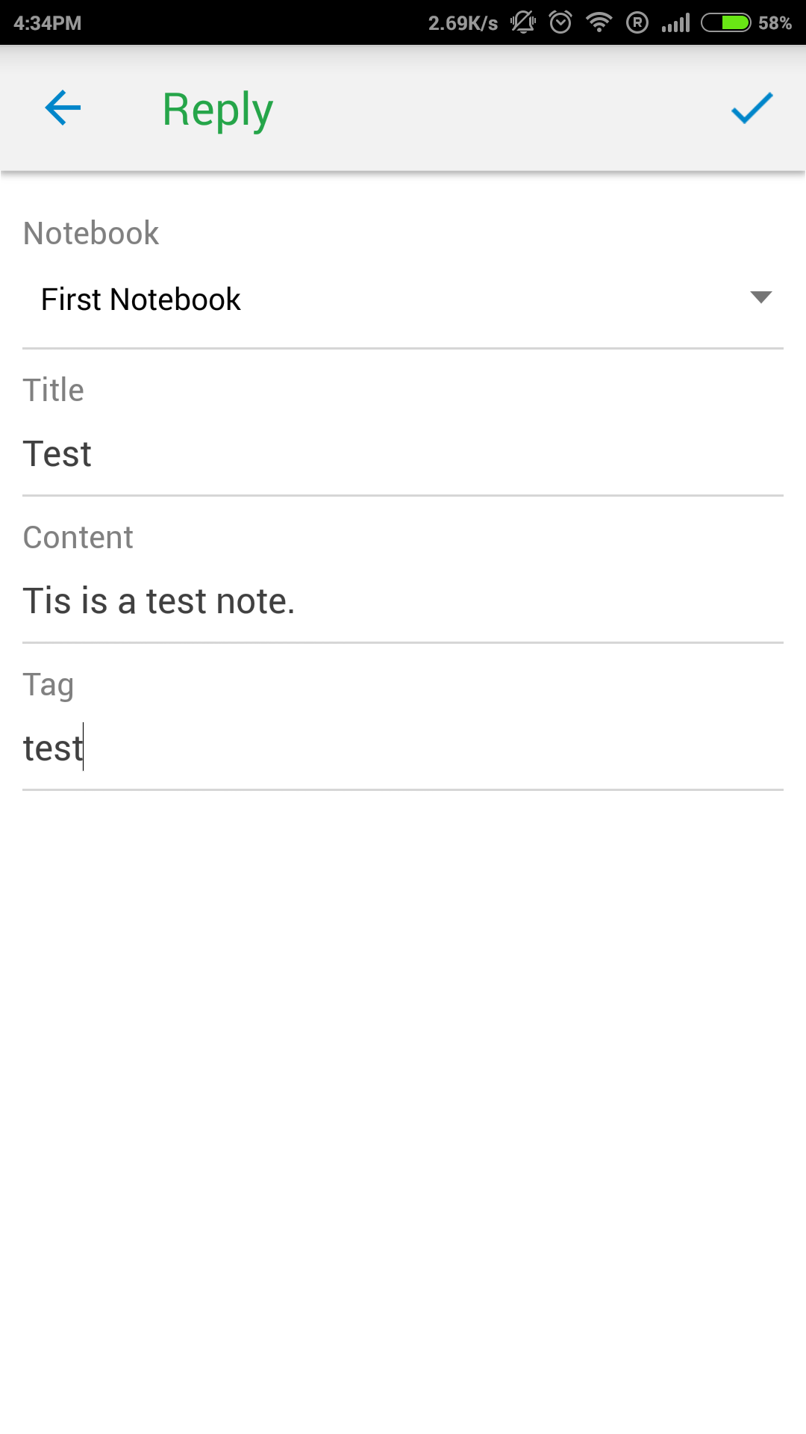
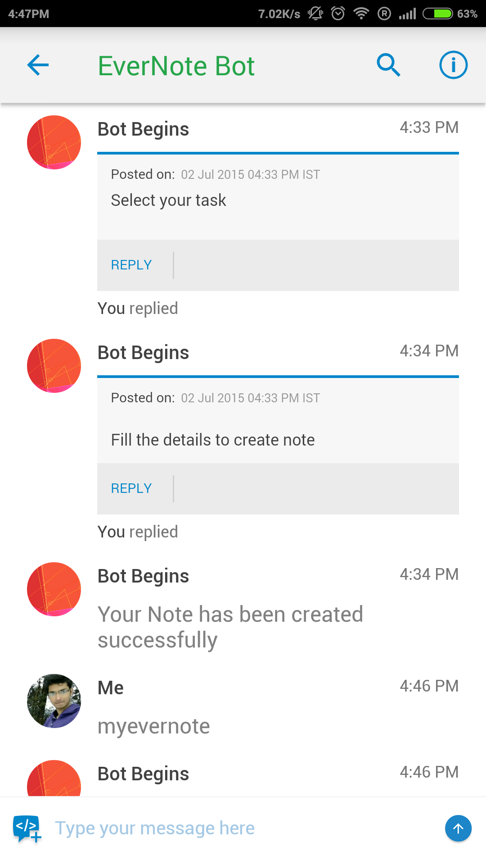
Add note on Evernote
Message shows successful creation of notes.

Slide 7
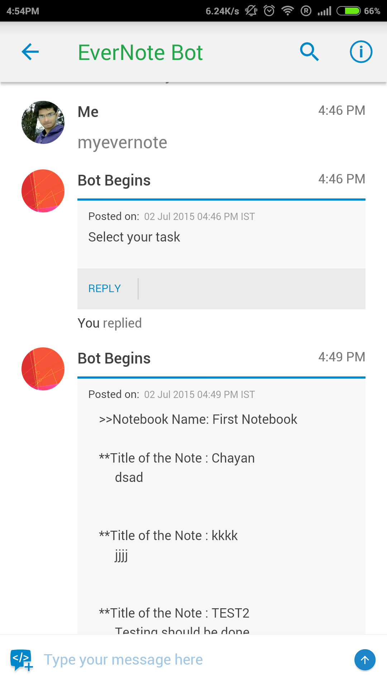
View notes on Evernote
Select view notes from the dropdown button.

Slide 8

Thank You

